Slide 1

Complaint categorization in the financial sector
By Aditya Joseph James & Yash Solanky
B565 Data Mining – Fall 2021
8th Dec’21
Image reference: https://www.wallpaperflare.com/geometry-cyberspace-digital-art-blue-lines-abstract-cloud-sky-wallpaper-pjcsi/download/1920x1080

Slide 2
91% of customers who have had a bad customer experience leave the brand without warning
This loss of customers can result in decreased profits and negative branding for the company
Consumer reaction to bad customer service*
91%
leave without warning
47%
Switch brand
40%
Would not recommend the business to others
33%
Consider switching companies
27%
It is their top frustration
Consumer service channels that consumers use*
62%
Use Email
47%
Use live chat
41%
Use in-person
12%
Mobile app
Given the above statistics our project aims to use complaints narrative to classify complaints to streamline the resolution process
* https://financesonline.com/customer-service-statistics/

Slide 3

Classification of complaints into issue categories based on the complaint narrative
Data obtained from consumer financial protection bureau available on Kaggle
161 different issues types across 1.28M complaints
Occurrences of same issue tag across products
9 different issues types
>10,000 occurrences in the data
Filtered
Might have similar narratives
Might have similar narratives
Might have similar narratives
https://www.kaggle.com/selener/consumer-complaint-database

Slide 4
Implemented LSH to tag issue type based on the match of test narrative with train complaint narrative
Used the Minhash and MinhashLSHForest modules from the datasketch package to implement LSH
Prediction accuracy when the best match was taken
Prediction accuracy when the top 2 matches were taken
Overall accuracy ~ 30%
Overall accuracy ~ 50%

Slide 5
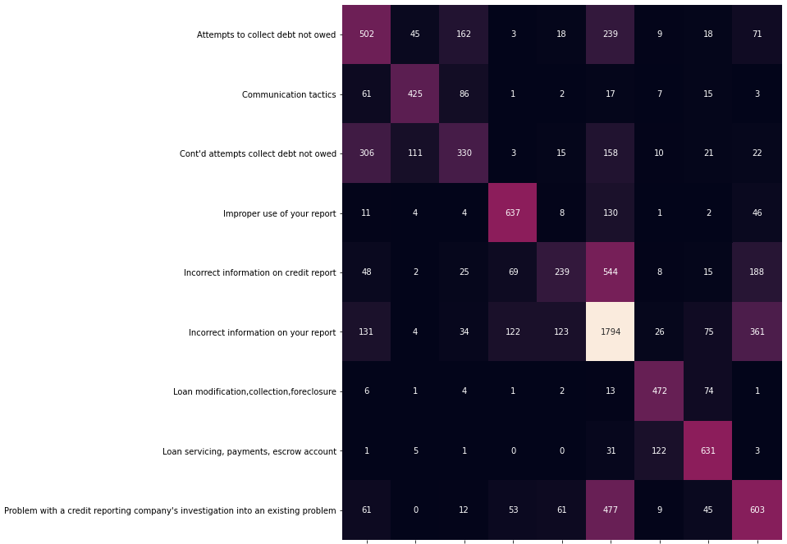
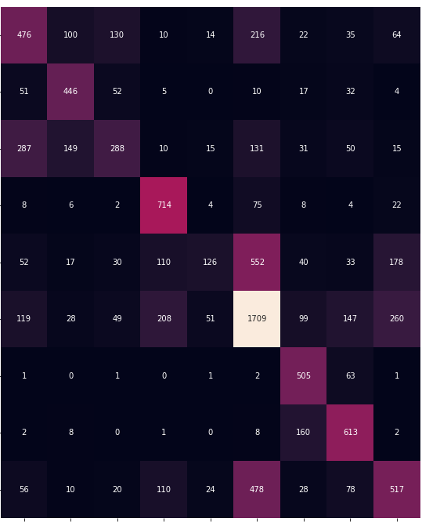
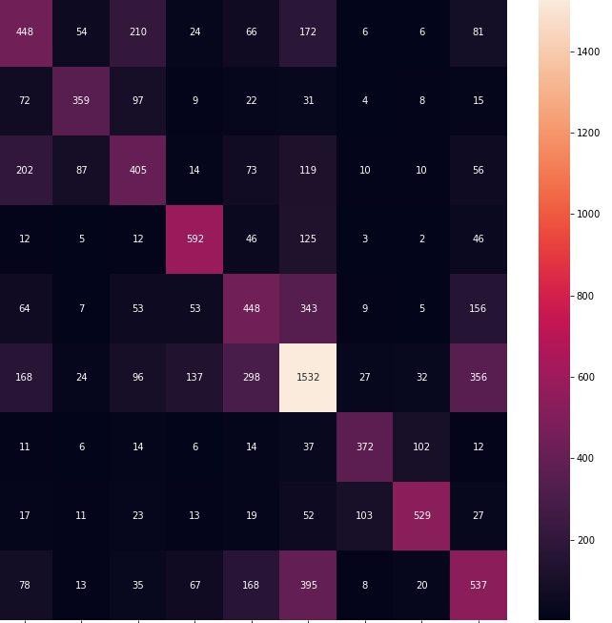
Results of classification of Issue from complaint narrative with Naïve bayes and SVM
Multinomial Naïve Bayes
Accuracy : 58%
Accuracy(Top 2) : 81%
Compliment Naïve Bayes
Accuracy : 54%
Accuracy(Top 2) : 77%
Support vector machine
Accuracy : 58%

Slide 6
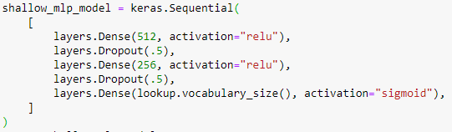
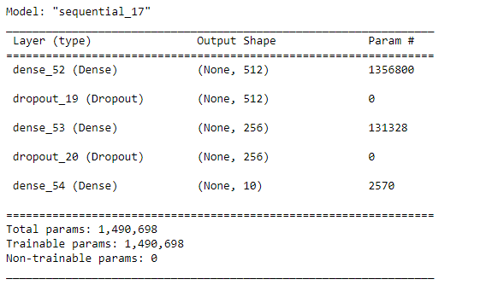
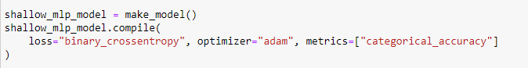
Classification of Issue from complaint narrative with Keras large-scale multi-label text classification

Slide 7
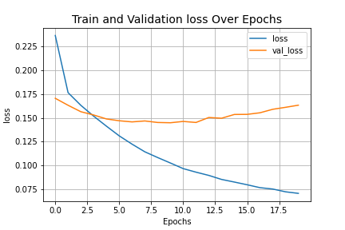
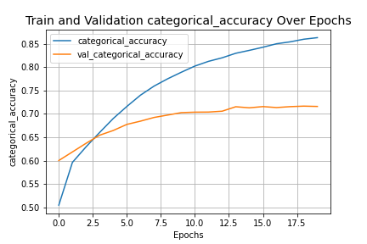
Results of classification of Issue from complaint narrative with Keras large-scale multi-label text classification
Accuracy on Test set: 70.89%

Slide 8
Future work and next steps
Further refinement of data to minimize overlap between issues
Combining categories with similar issue type
Try and implement RoBERTa (by Facebook) to further improve the results

Slide 9
Thank you

